Slide 1
Novelty Search
Spring 2022
Winston Koh & Anh Pham
Qiu Lab
Biology Department, Hunter College, CUNY

Slide 2
Project outline
Part 1. Model & tool development using simulated landscapes
Generate landscapes (monotonic, random, NK & RMF)
Implement & validate objective, novelty, and mixed search algorithms
Develop pipeline, visualization, and statistics
Part 2. Applications to Flu, HIV, and/or CoV-2 evolution
Generate fitness landscapes based on haplotype frequencies or use published CoV-2 landscape
Can we replicate the evolution of alpha, delta, and omicron variants, including emergence periodicity?
Predict the emergence of future pandemic variants

Slide 3
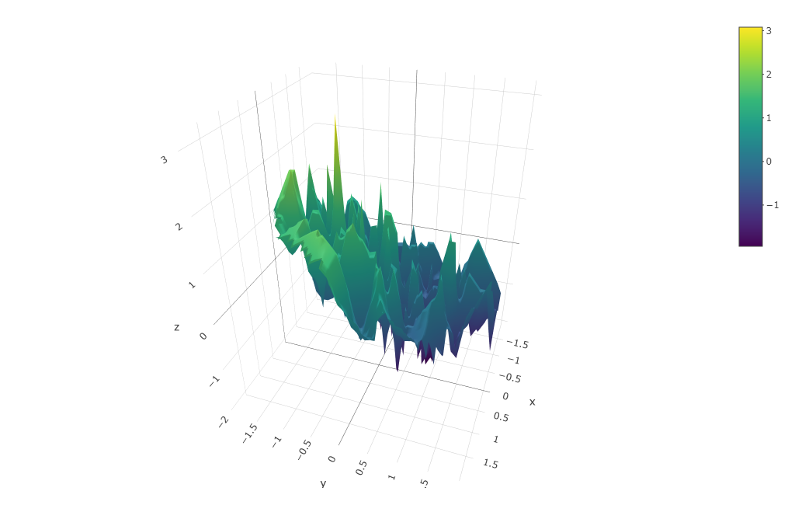
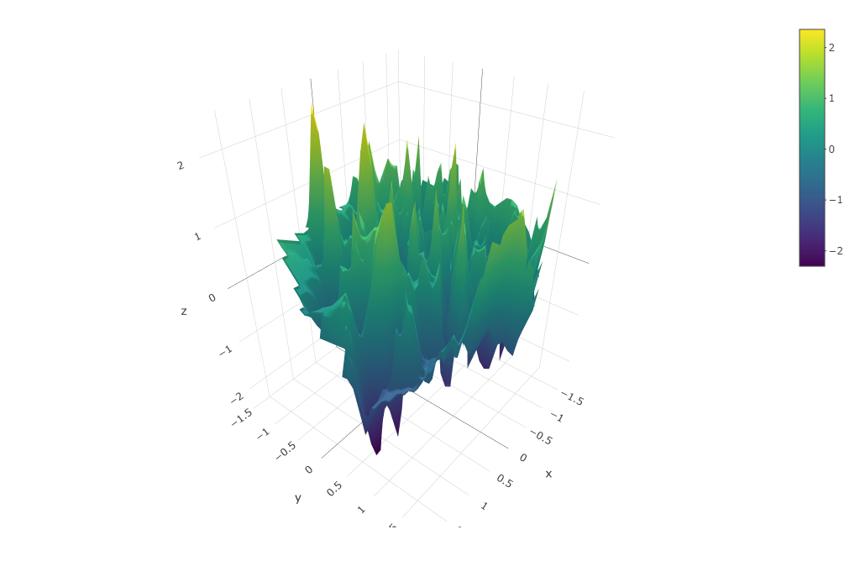
Generate fitness landscapes of binary strings
Haplotype length = 50 bits; Num of haplotype = 500; Fitness ~ Normal (0,1); 2D Projection: PCA
Monotonic
fitness increases with the number of 0’s
Random
fitness randomly assigned to haplotype
Fitness
Folder: “cov-db/scripts/”
Scripts: “gen-fit-landscape.py –m {2,4} ”
“binary-project-2D.py –land” (SciKit-Learn)
“plot-search.R” (plotly)
Other (more standard) landscapes to try:
NK
Rough Mt Fuji (RMF): similar to “monotomic” here
Polynomial (with 2-way and 3-way interactions)

Slide 4
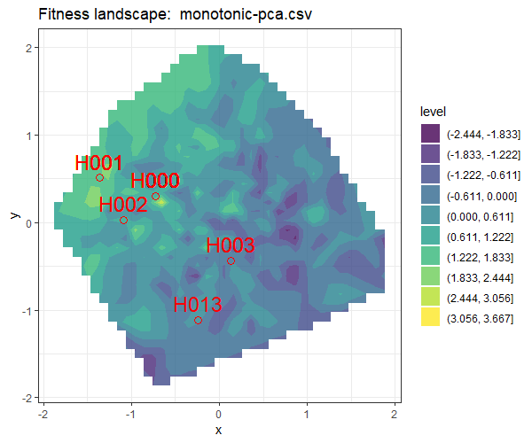
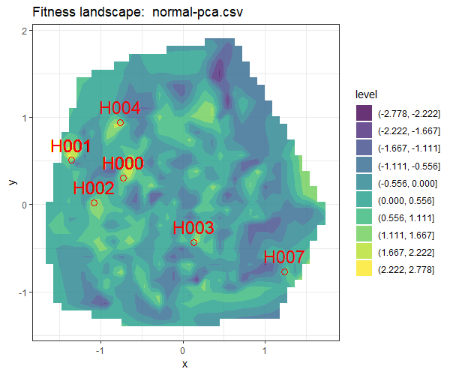
Objective Search: Populations often get stuck in local peaks in highly rugged landscapes
H000 is the fitness peak; IDs ranked by fitness; 2D projection by PCA
Search algorithm: mutation rate = 1 per genome per generation; pick top 10 elites on the landscape
(1)
(4)
(11)
(7)
(6)
(2)
(3)
(3)
(2)
(1)
(1)
Folder: “cov-db/scripts/”; Scripts: “plot-search.R”

Slide 5
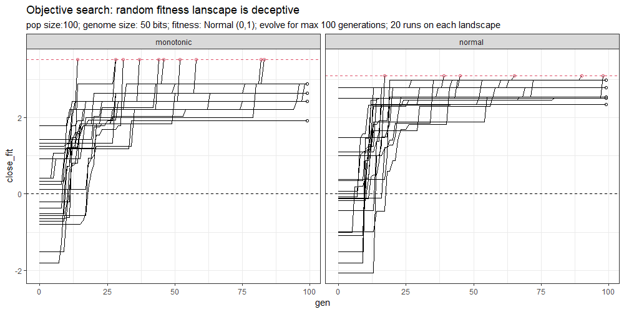
Objective search path: population never travels downhill
N=11 peaked
N=9 failed
N=6 peaked
N=14 failed
Folder: “cov-db/scripts/”; Scripts: “binary-search.py –alg 1”

Slide 6
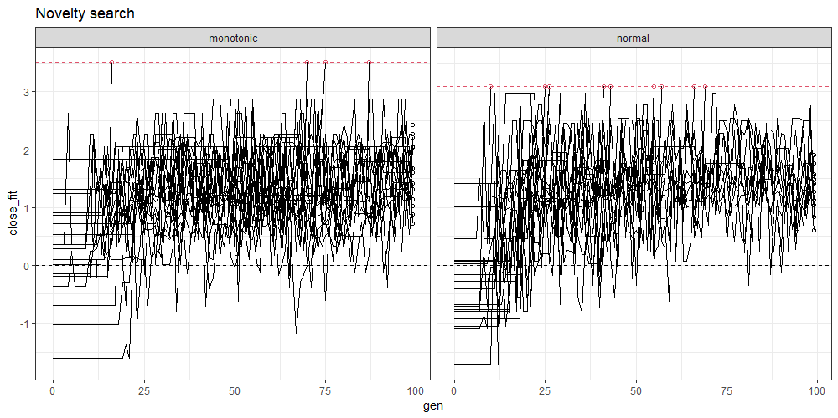
Novelty search path: population makes complex moves including downhill trips
N=4 peaked
N=16 failed
N=9 peaked
N=11 failed
Folder: “cov-db/scripts/”; Scripts: “binary-search.py –alg 2”

Slide 7
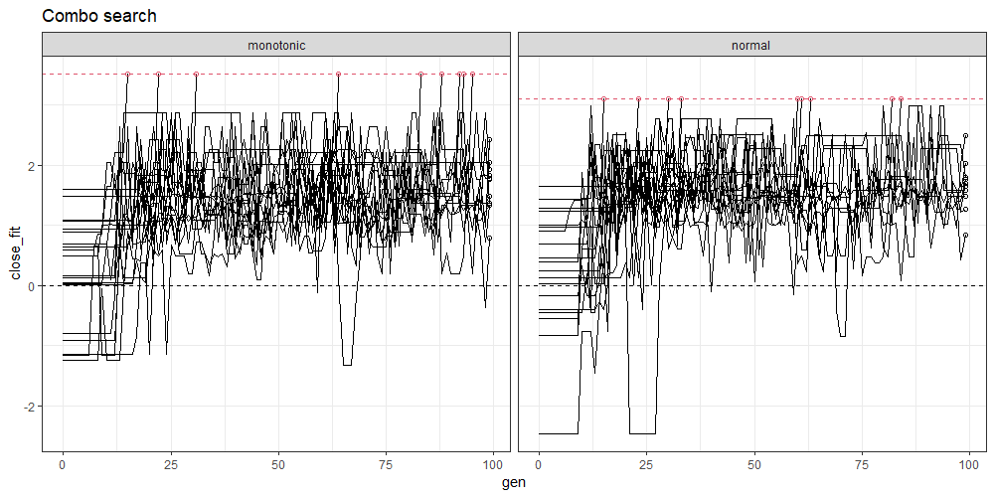
Combo search path: population makes complex moves including downhill trips (with significant fitness drops)
N=9 peaked
N=11 failed
N=9 peaked
N=11 failed
Folder: “cov-db/scripts/”; Scripts: “binary-search.py –alg 3”

Slide 8
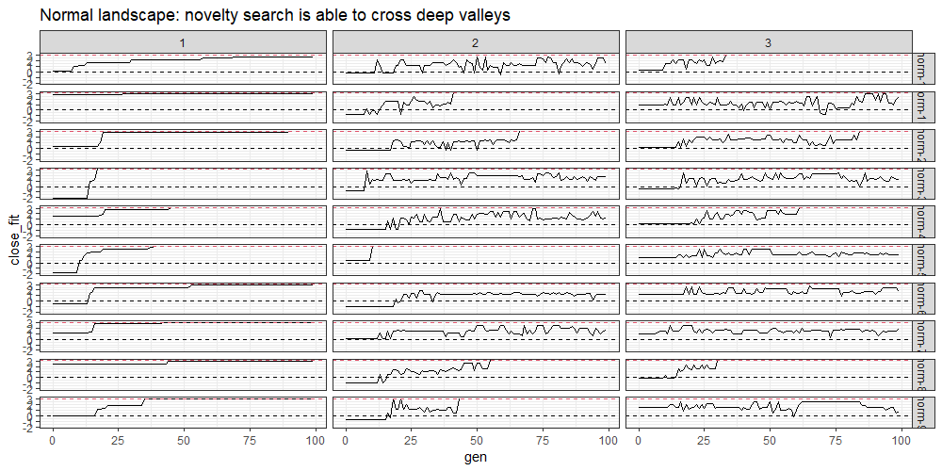
Objective
Novelty
Mixed
Folder: “cov-db/scripts/”; Scripts: “binary-search.py –alg {1,2,3}”

Slide 9
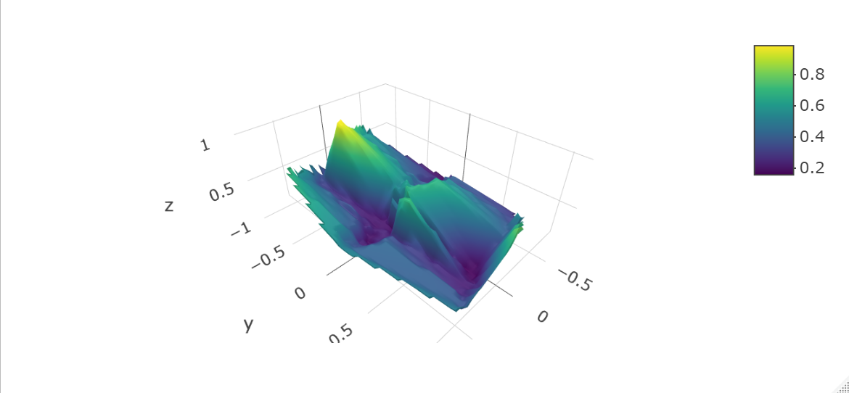
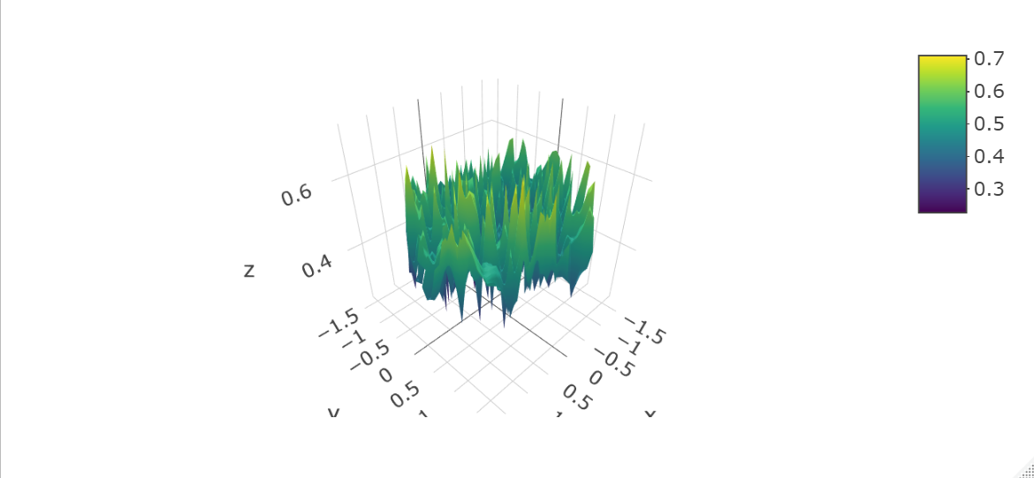
Generate fitness landscapes of binary strings: NK models
NK (N = 10, hap = 950/1024, Nmax = 4, , r/s = 2.71 )
NK (N = 20, hap = 10K/1M, Nmax = 12 , r/s = 1.50 )
Fitness
Folder: “cov-db/scripts/”
Scripts: nk_rmf_models.py –N 10 -model ‘NK’ –hap_num 950
Folder: “cov-db/scripts/”
Scripts: nk_rmf_models.py –N 20 -model ‘NK’ –hap_num 10000

Slide 10
Searches on NK landscapes: not deceptive enough (objective searches prevailed)
35/40 peaked
15/40 peaked
33/40 peaked
20/20 peaked
13/20 peaked
16/20 peaked

Slide 11
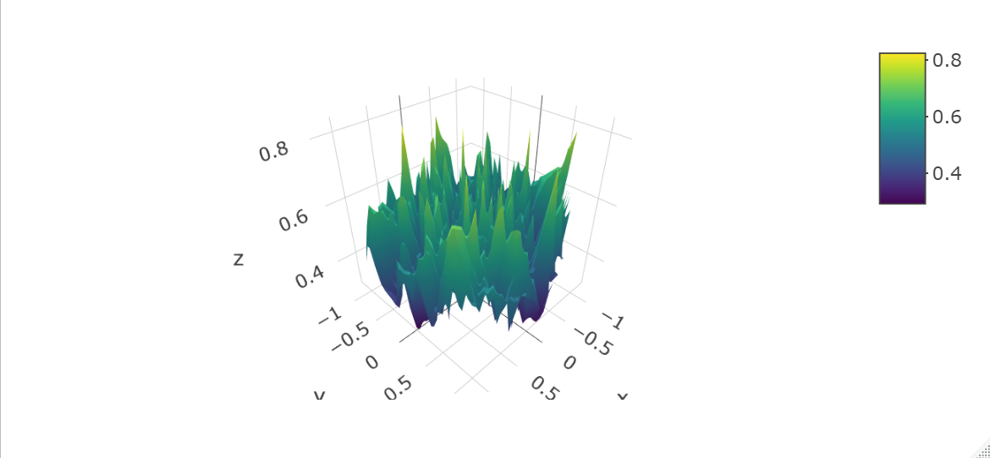
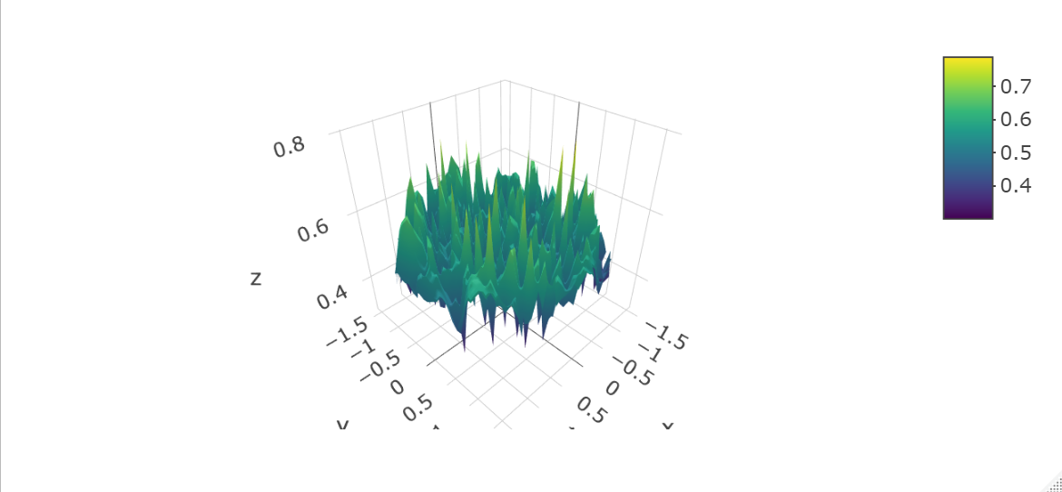
Generate fitness landscapes of binary strings: Rough Mt Fuji (RMF) models
RMF (N = 10, hap = 950/1024, Nmax = 98, r/s = 8.56)
RMF (N = 20, hap = 10K/1M, Nmax = 49K , r/s = 9.99 )
Fitness
Folder: “cov-db/scripts/”
Scripts: nk_rmf_models.py –N 10 -model ‘rmf’ –hap_num 950
Folder: “cov-db/scripts/”
Scripts: nk_rmf_models.py –N 20 -model ‘rmf’ –hap_num 10000

Slide 12
Searches on RMF landscapes: highly deceptive when N=20
20/20 peaked
13/20 peaked
20/20 peaked
10/20 peaked
17/20 peaked
16/20 peaked

